Slide 1
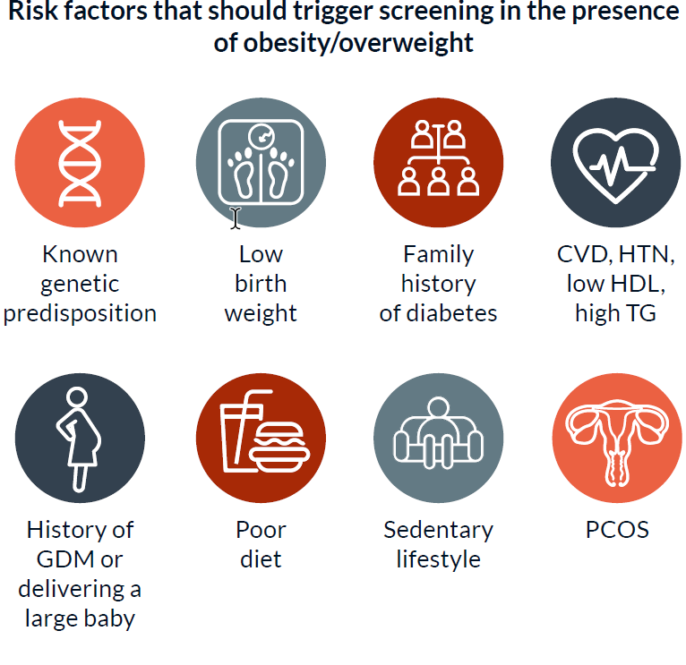
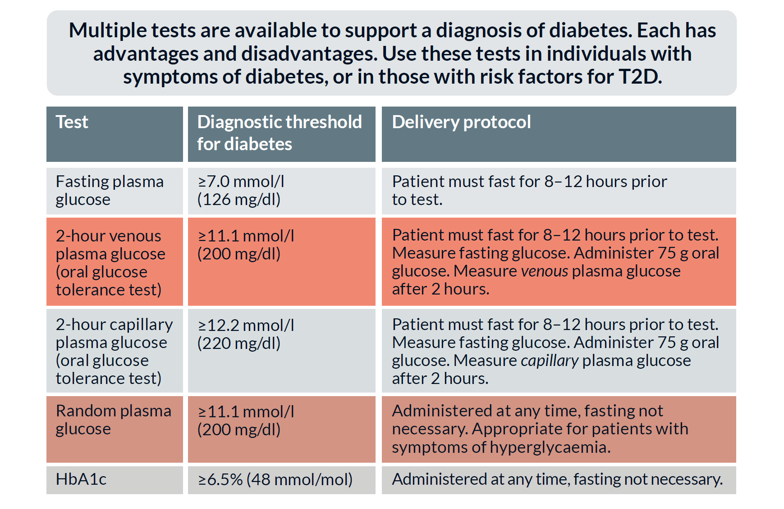
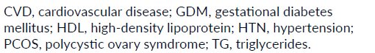
Diabetes screening and diagnosis
Screening for hyperglycaemia can help to identify people who are at risk for preventable diabetes complications so that earlier treatment can be offered. Early diagnosis and treatment of type 2 diabetes are associated with improved life expectancy and quality of life.
Multiple tests are available to support a diagnosis of diabetes

